Slide 1

ANDROID DEVELOPMRNT- INTRODUCTION
BY:
KUNAL FARMAH (B.TECH, IT 2ND YEAR)
SHIVAM KUMAR (B.TECH, COE 2ND YEAR)
IEEE MENTOR : SAMARTH GUPTA

Slide 2
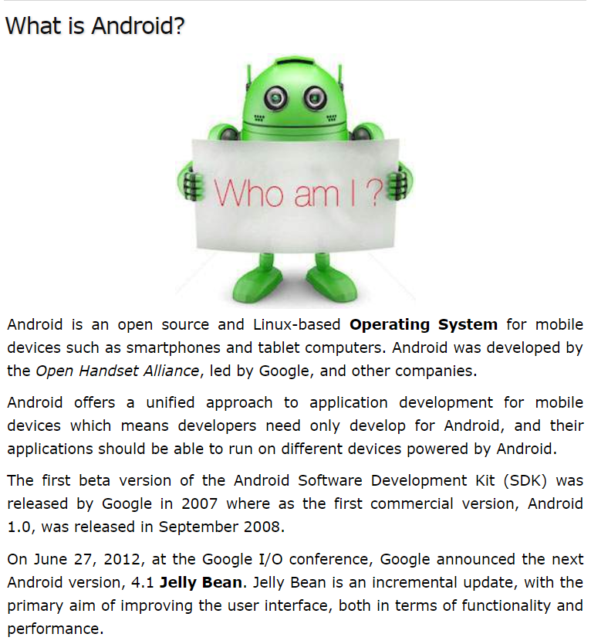
ANDROID - AN OVERVIEW

Slide 3
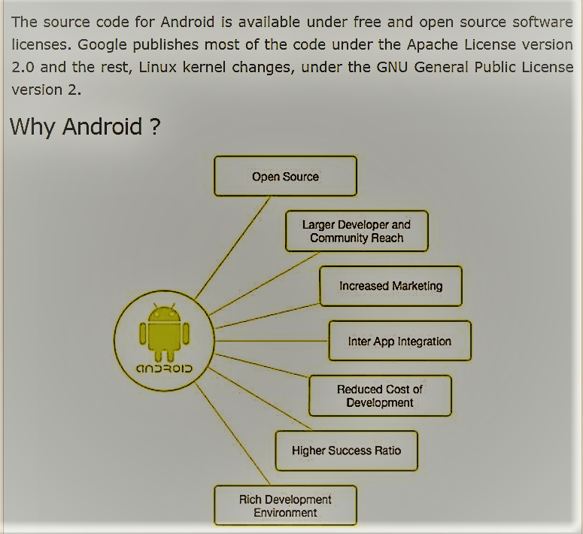

Slide 4
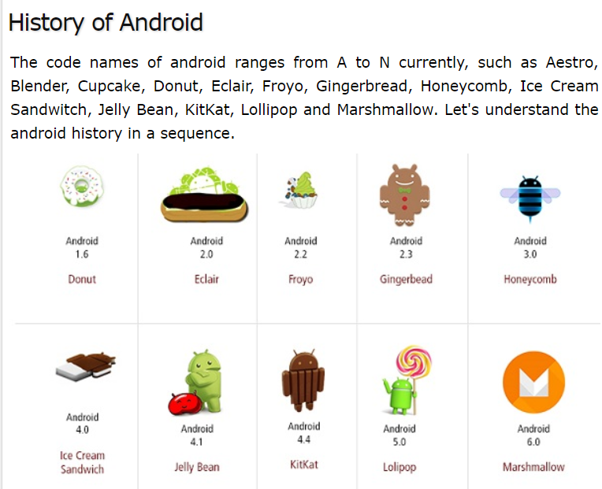

Slide 5
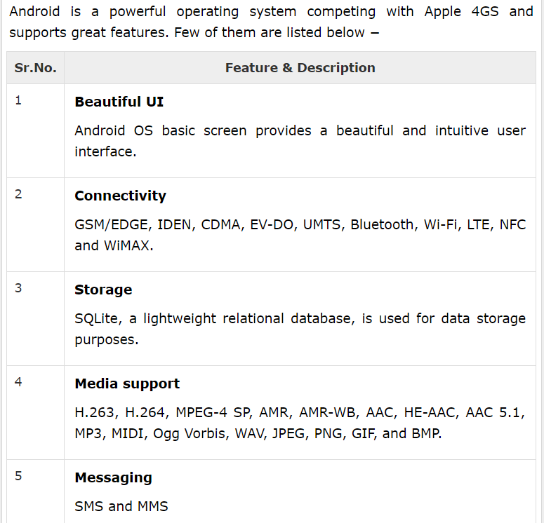
FEATURES:

Slide 6
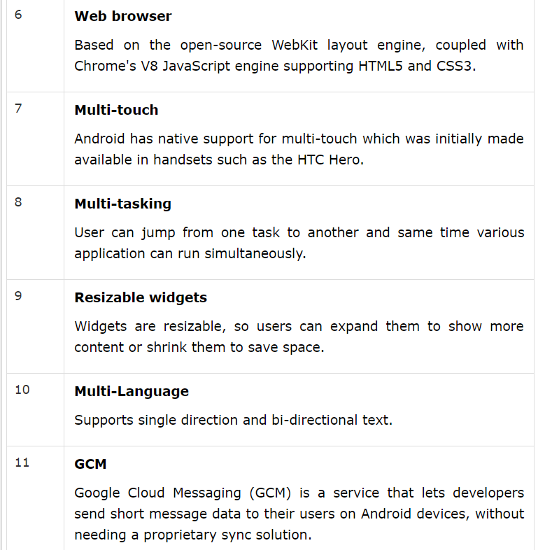

Slide 7
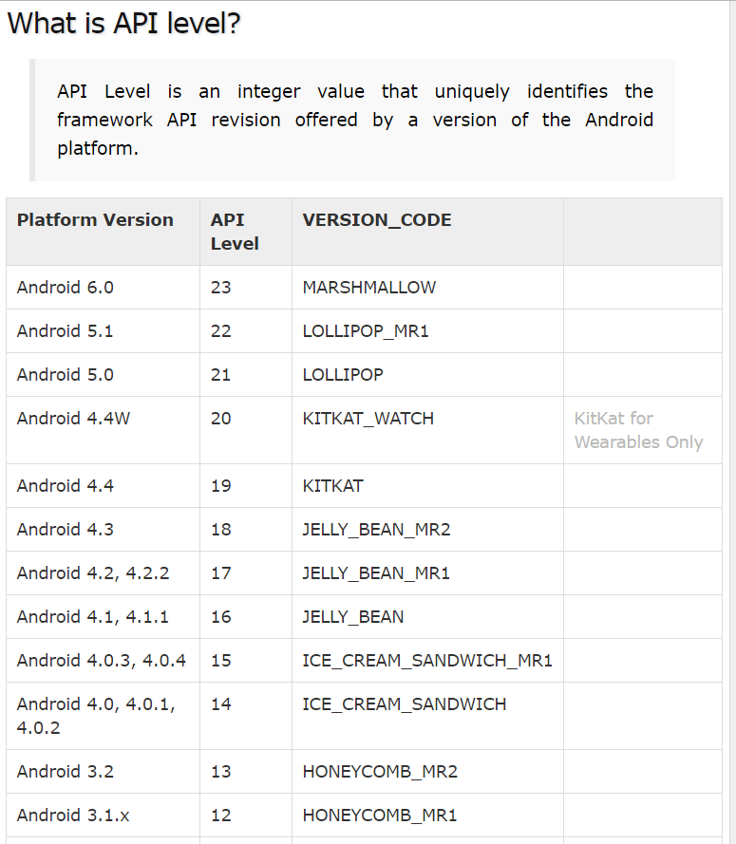

Slide 8
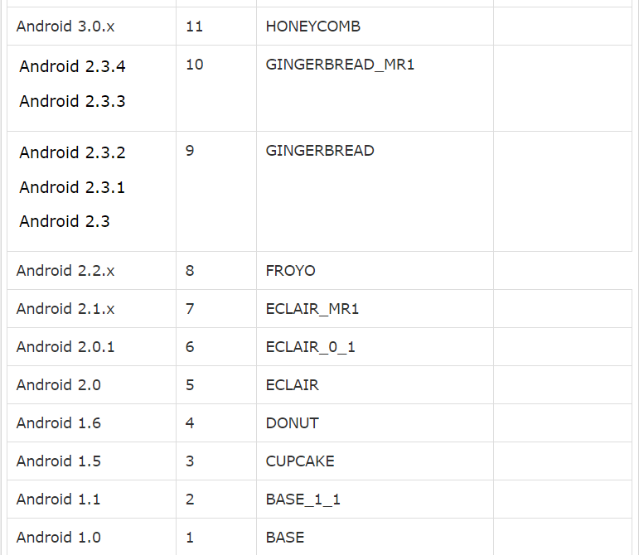

Slide 9
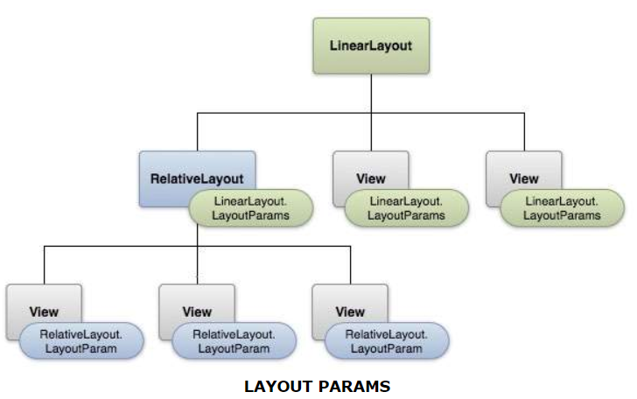
USER INTERFACE (UI/UX)

Slide 10
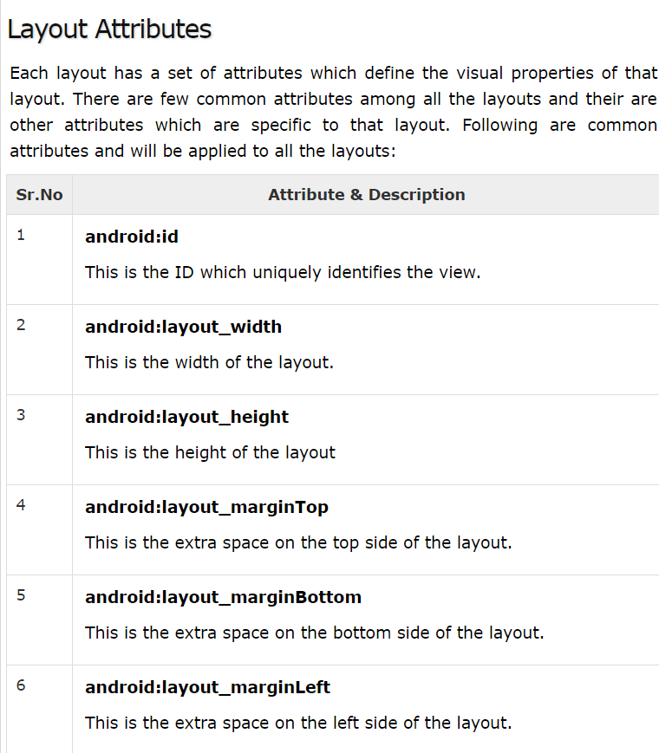

Slide 11
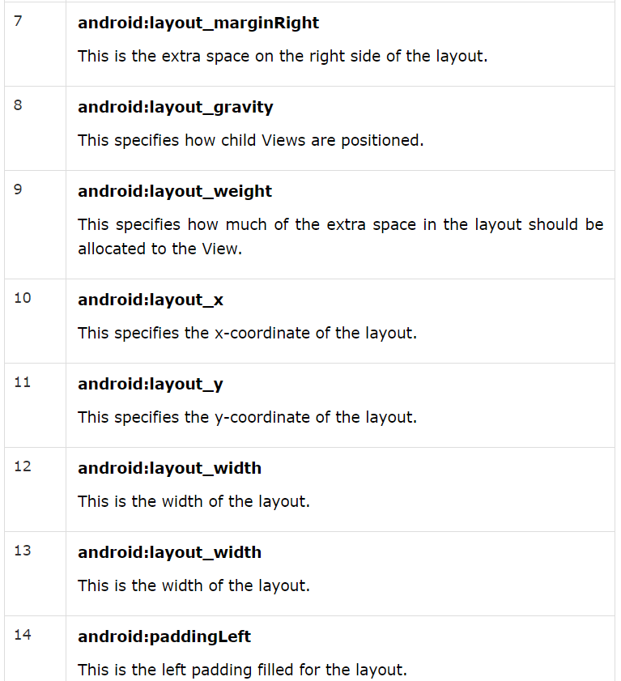

Slide 12
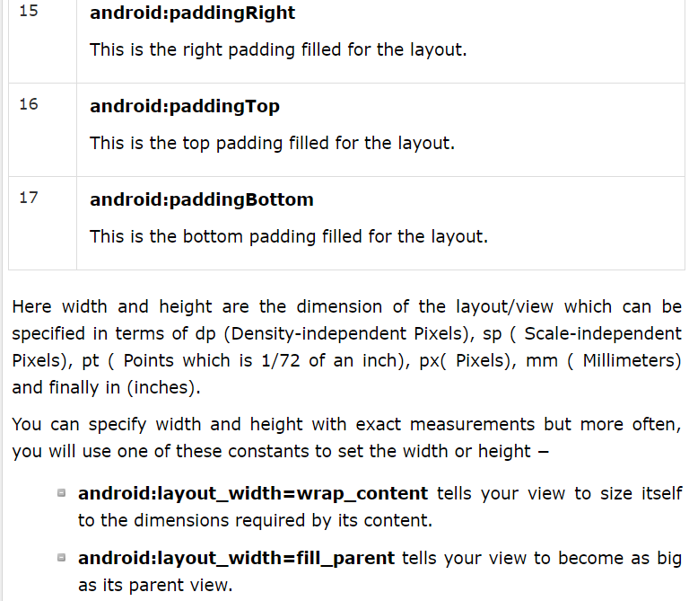

Slide 13
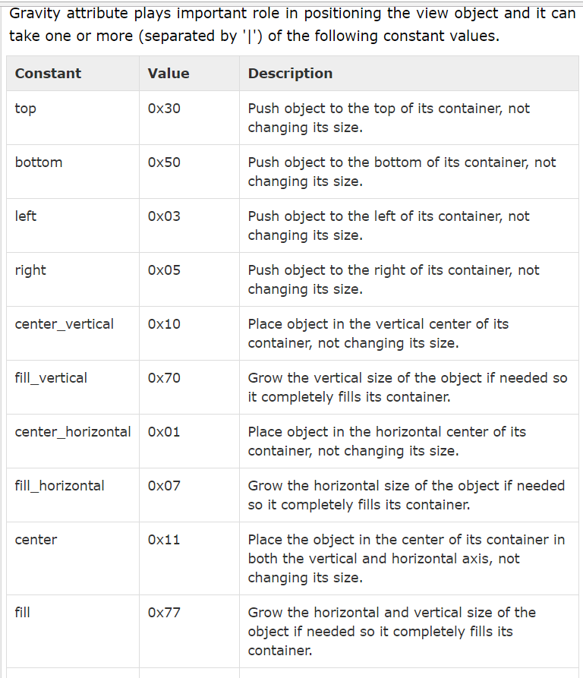
GRAVITY:

Slide 14
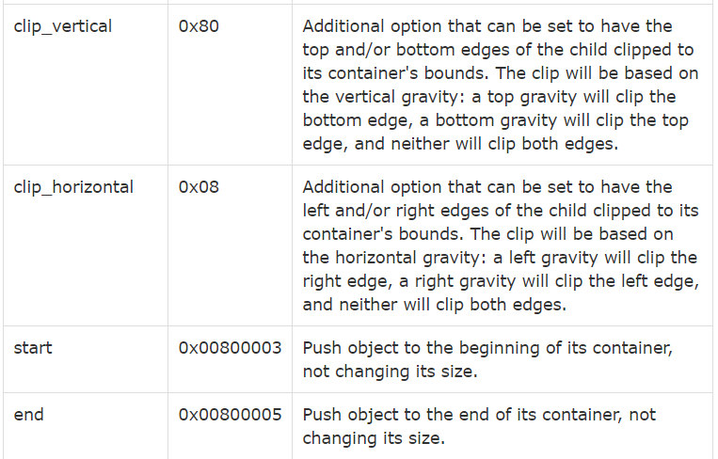

Slide 15
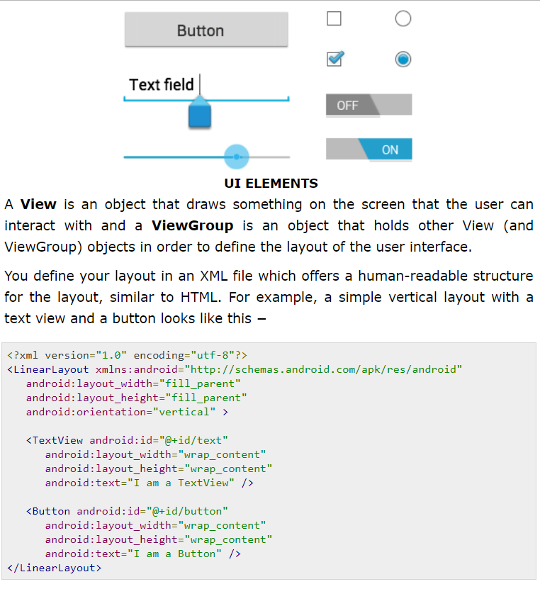
LAYOUT COMPONENTS:

Slide 16
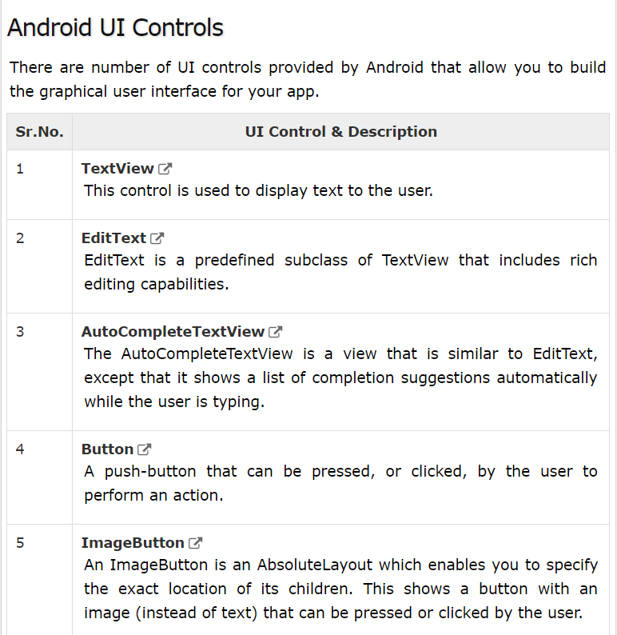

Slide 17
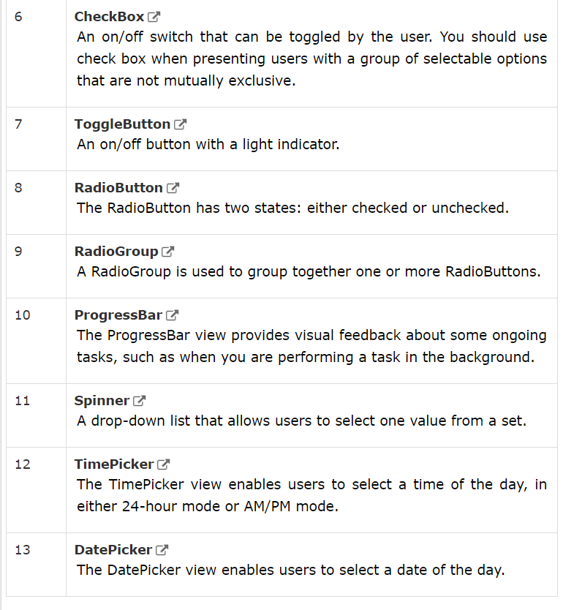

Slide 18
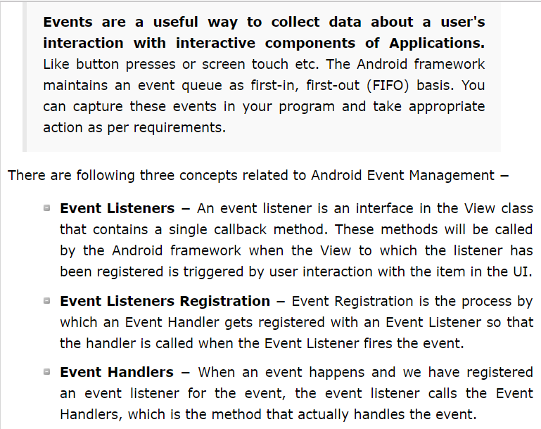
EVENTS:

Slide 19
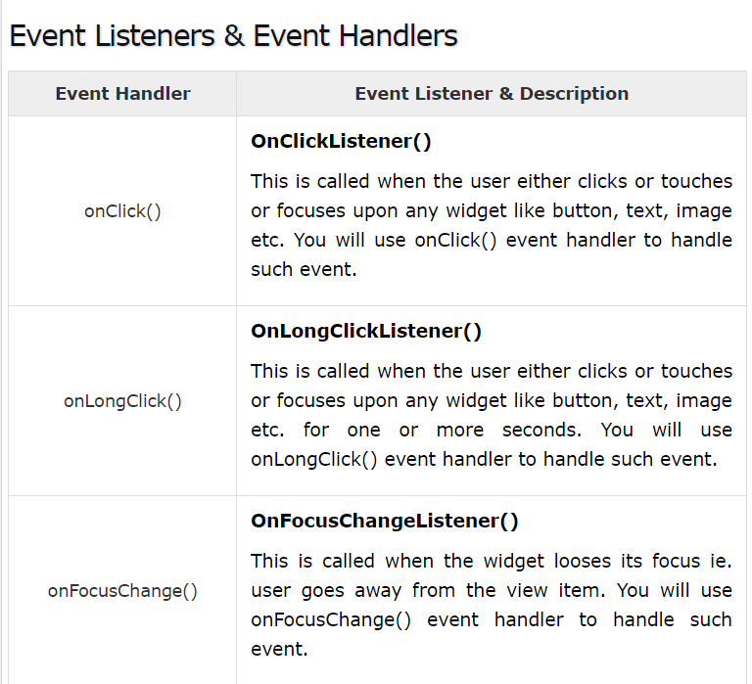

Slide 20
